Slide 1
Searching Algorithm Techniques

Slide 2
1. Linear Search
Linear search is a type of sequential searching algorithm
every element within the input array is traversed and compared with the key element to be found.
If a match is found in the array the search is said to be successful
if there is no match found the search is said to be unsuccessful

Slide 3
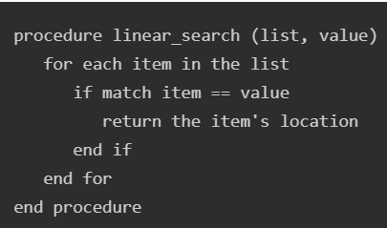
Linear Search Algorithm
Step 1 − Start from the 0th index of the input array, compare the key value with the value present in the 0th index.
Step 2 − If the value matches with the key, return the position at which the value was found.
Step 3 − If the value does not match with the key, compare the next element in the array.
Step 4 − Repeat Step 3 until there is a match found. Return the position at which the match was found.
Step 5 − If it is an unsuccessful search, print that the element is not present in the array and exit the program.

Slide 4
Binary Search Algorithm
Iterative and Recursive Implementation
used in a sorted array by repeatedly dividing the search interval in half.
The idea of binary search is to use the information that the array is sorted and reduce the time complexity to O(log N).

Slide 5
Binary Search Algorithm
Divide the search space into two halves by finding the middle index "mid".
Compare the middle element of the search space with the key.
If the key is found at middle element, the process is terminated.
If the key is not found at middle element, choose which half will be used as the next search space.
If the key is smaller than the middle element, then the left side is used for next search.
If the key is larger than the middle element, then the right side is used for next search.
This process is continued until the key is found or the total search space is exhausted.
EX: https://www.geeksforgeeks.org/dsa/binary-search/

Slide 6
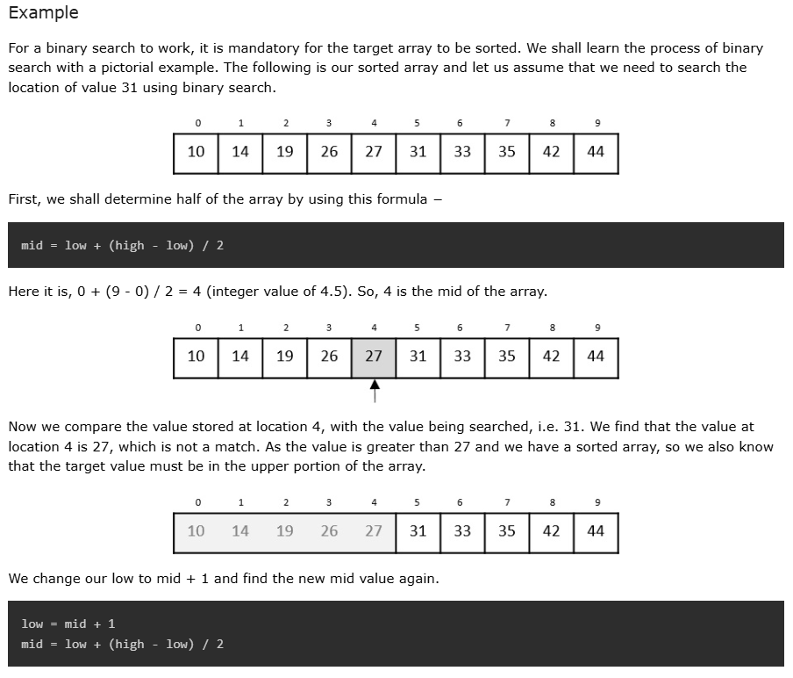
Steps

Slide 7
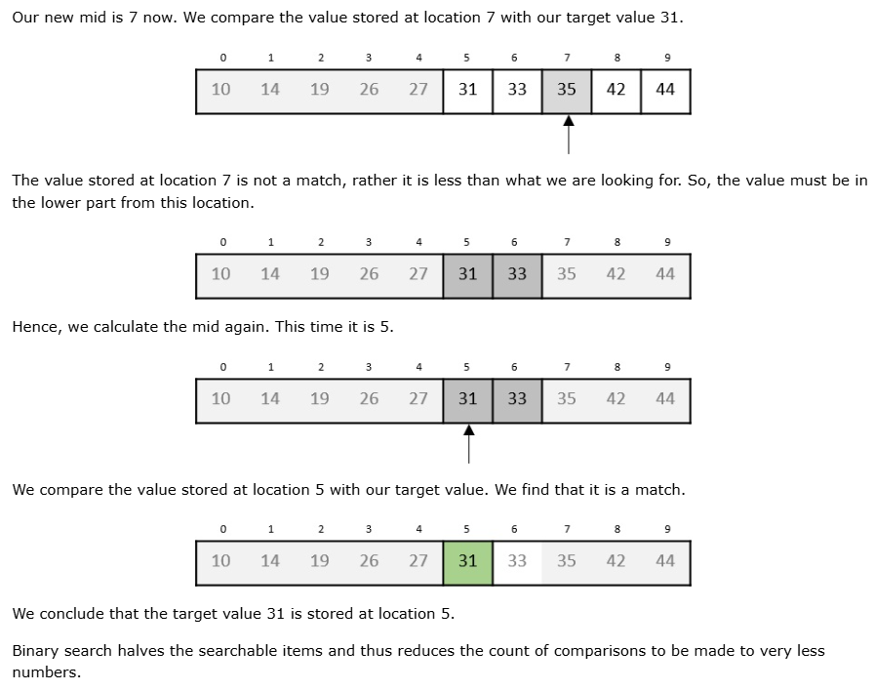

Slide 8
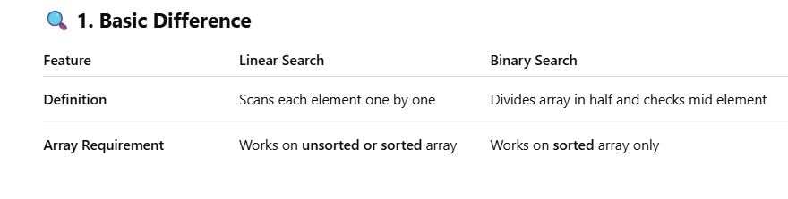
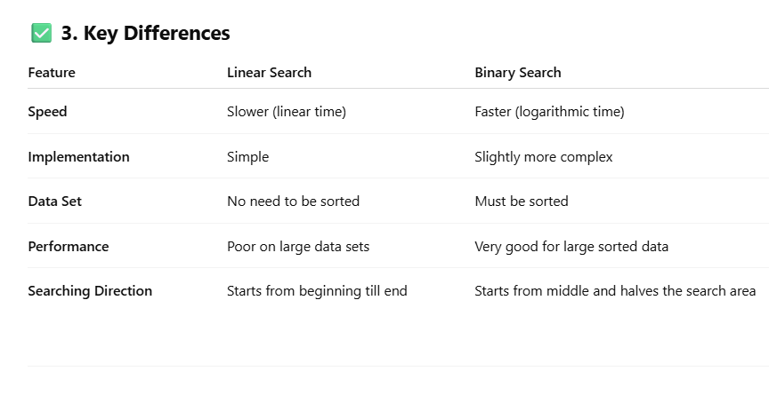

Slide 9
Use Linear Search when the data is unsorted or small.
Use Binary Search when the data is sorted and large for
better performance.

